Slide 1
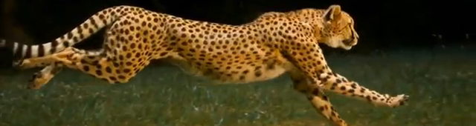

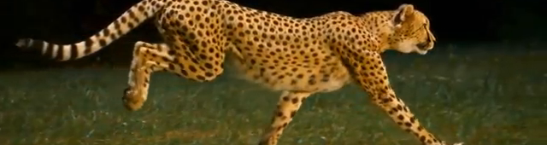

Motivation ☺
Input Image
Predicted Image
Same Patch Distribution!
NN loss

Slide 2
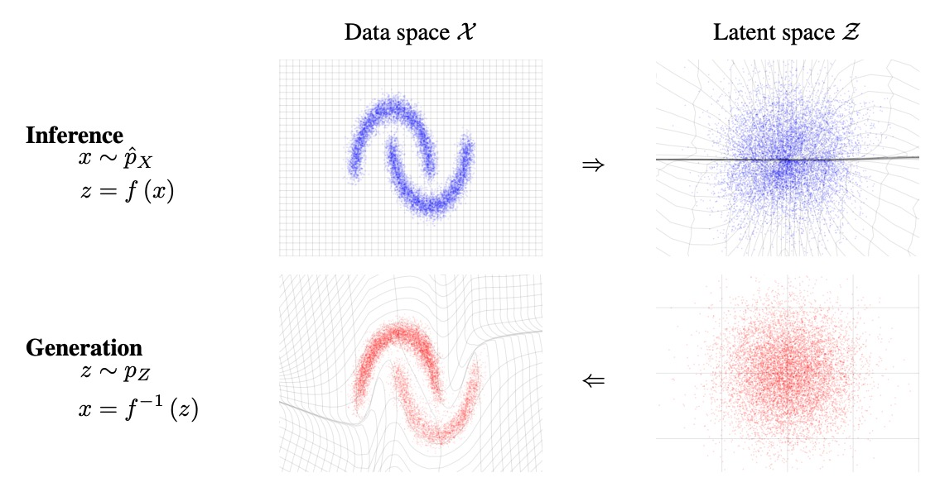
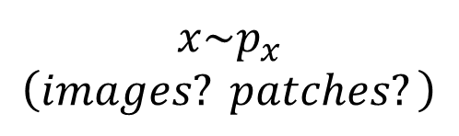
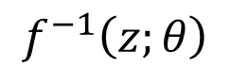
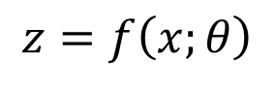
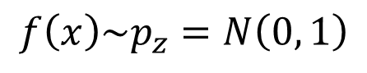
Normalizing Flows
$$x\sim p_{x} \\ \left(images? patches?\right)$$
$$f\left(x\right)\sim p_{z}=N\left(0, 1\right)$$
$$z=f\left(x;θ\right)$$
$$f^{−1}\left(z;θ\right)$$

Slide 3
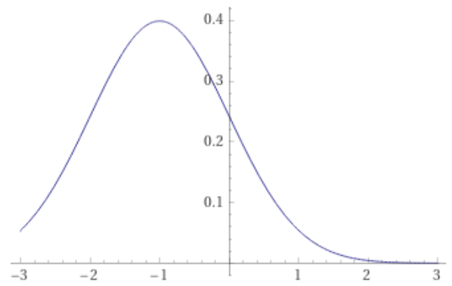
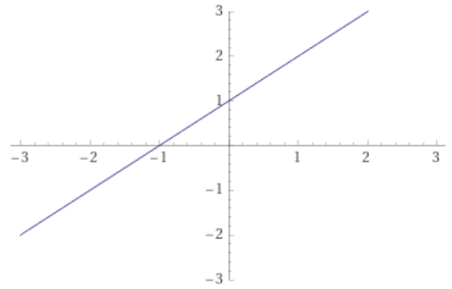
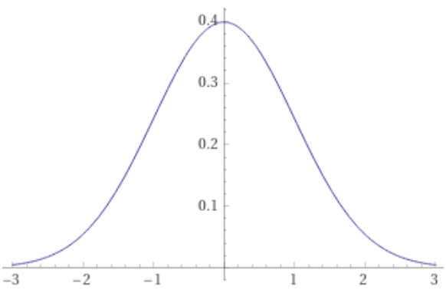
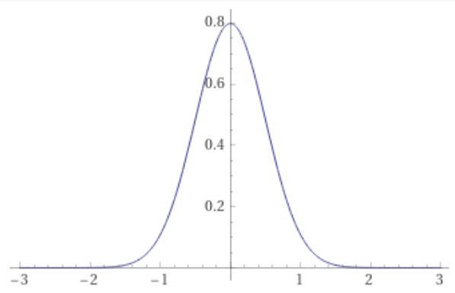
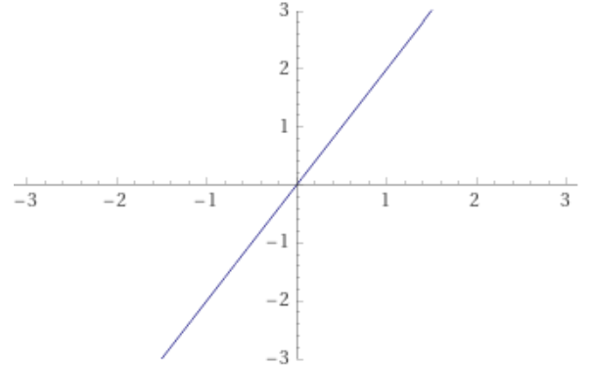
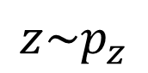
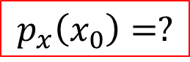
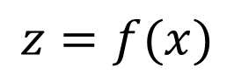
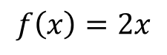
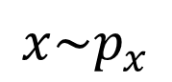
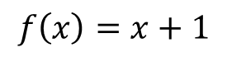
1D examples
$$x\sim p_{x}$$
$$z=f(x)$$
$$z\sim p_{z}$$
$$f\left(x\right)=x+1$$
$$p_{x}\left(x_{0}\right)=?$$
$$f\left(x\right)=2x$$

Slide 4
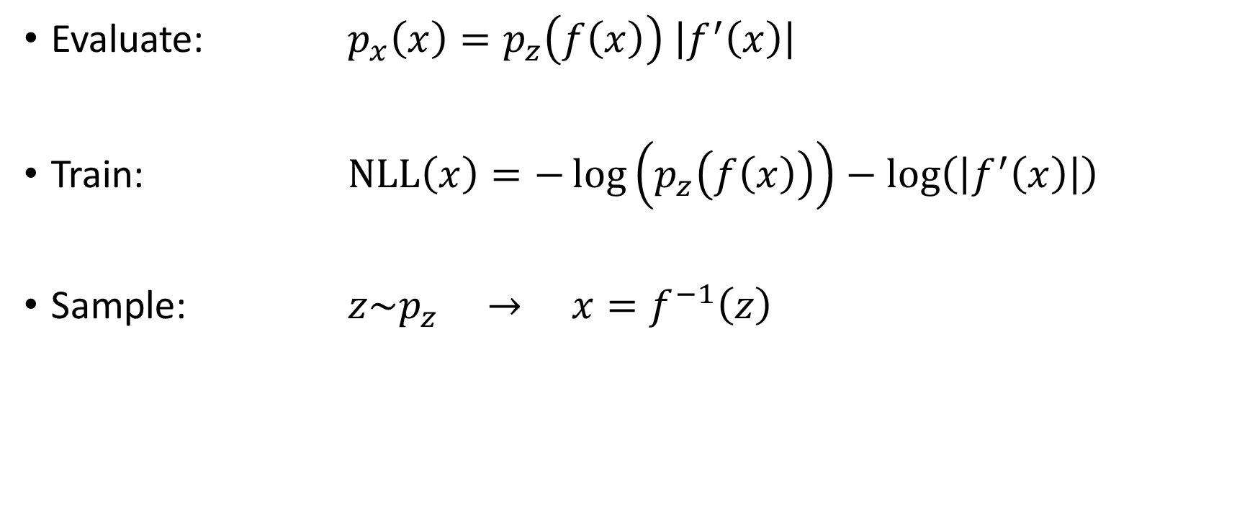
Equations
Evaluate: $p_{x}\left(x\right)=p_{z}\left(f\left(x\right)\right) \left|f^{′}\left(x\right)\right|$
Train: $NLL\left(x\right)=−\log\left(p_{z}\left(f\left(x\right)\right)\right)−\log\left(\left|f^{′}\left(x\right)\right|\right)$
Sample: $z\sim p_{z} → x=f^{−1}\left(z\right)$

Slide 5
Normalizing Flows
$$x\sim p_{x} \\ \left(images? patches?\right)$$
$$f\left(x\right)\sim p_{z}=N\left(0, 1\right)$$
$$z=f\left(x;θ\right)$$
$$f^{−1}\left(z;θ\right)$$

Slide 6
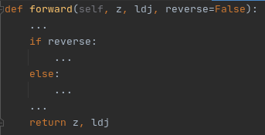
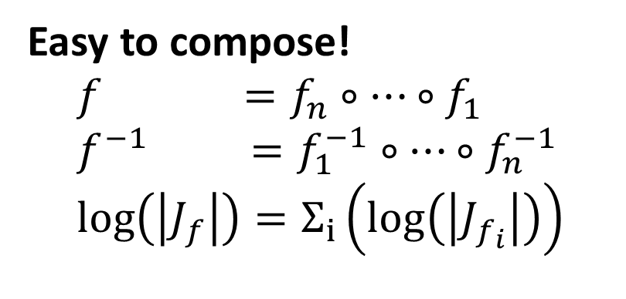
Implementation
Requirements:
Invertible
Easy to compute: forward / inverse / Jacobean
Expressive
Easy to compose!
$$f =f_{n}∘…∘f_{1} \\ f^{−1} =f_{1}^{−1}∘…∘f_{n}^{−1} \\ log\left(\left|J_{f}\right|\right)=Σ_{i}\left(log\left(\left|J_{f_{i}}\right|\right)\right)$$

Slide 7
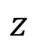
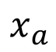
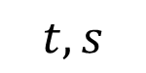
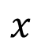
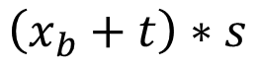
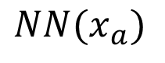
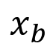
Implementation
Coupling Layer:
$$x_{a}$$
$$NN(x_{a})$$
$$x$$
$$z$$
$$t,s$$
$$\left(x_{b}+t\right)∗s$$
$$x_{b}$$

Slide 8
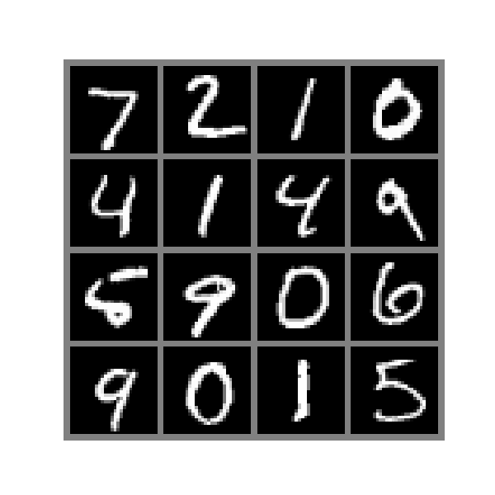
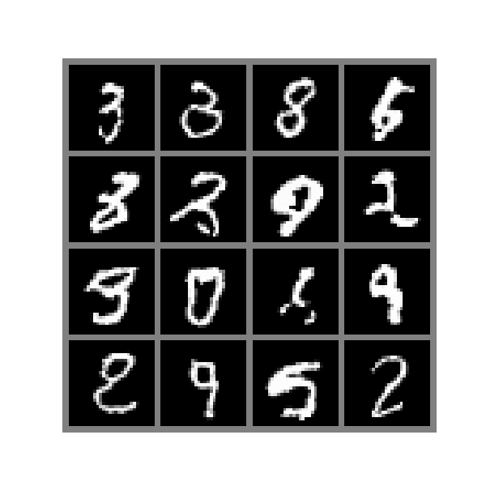
Normalizing Flows
$$x\sim p_{x} \\ \left(images? patches?\right)$$
$$f\left(x\right)\sim p_{z}=N\left(0, 1\right)$$
$$z=f\left(x;θ\right)$$
$$f^{−1}\left(z;θ\right)$$

Slide 9
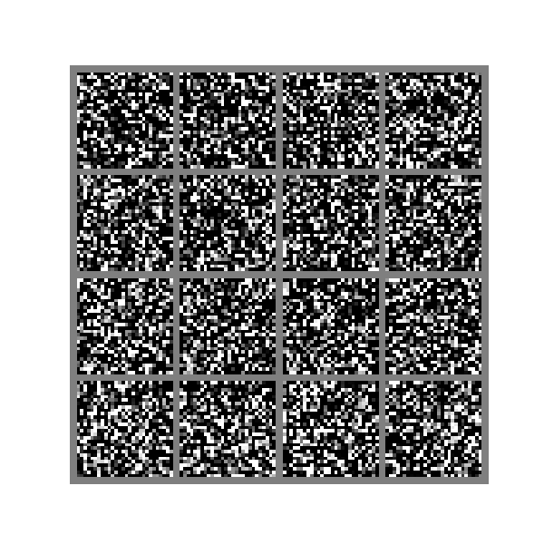
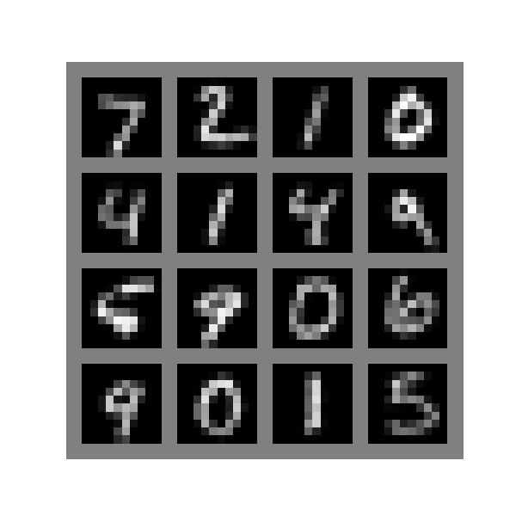
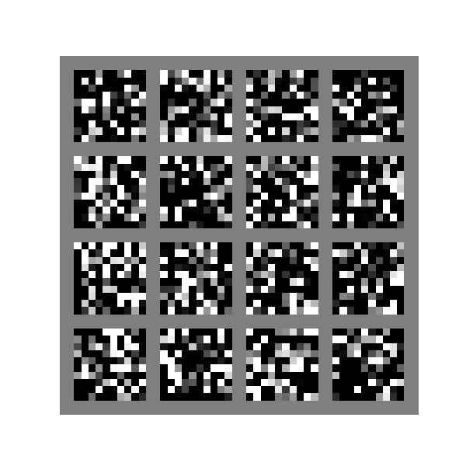
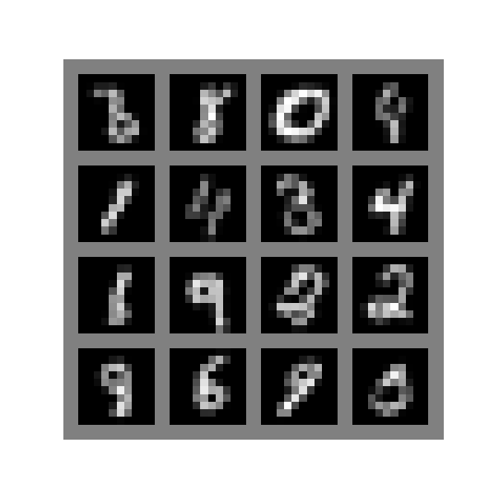
Experiments
MNIST 28*28 Dataset Samples
MNIST 10*10 Dataset Samples

Slide 10
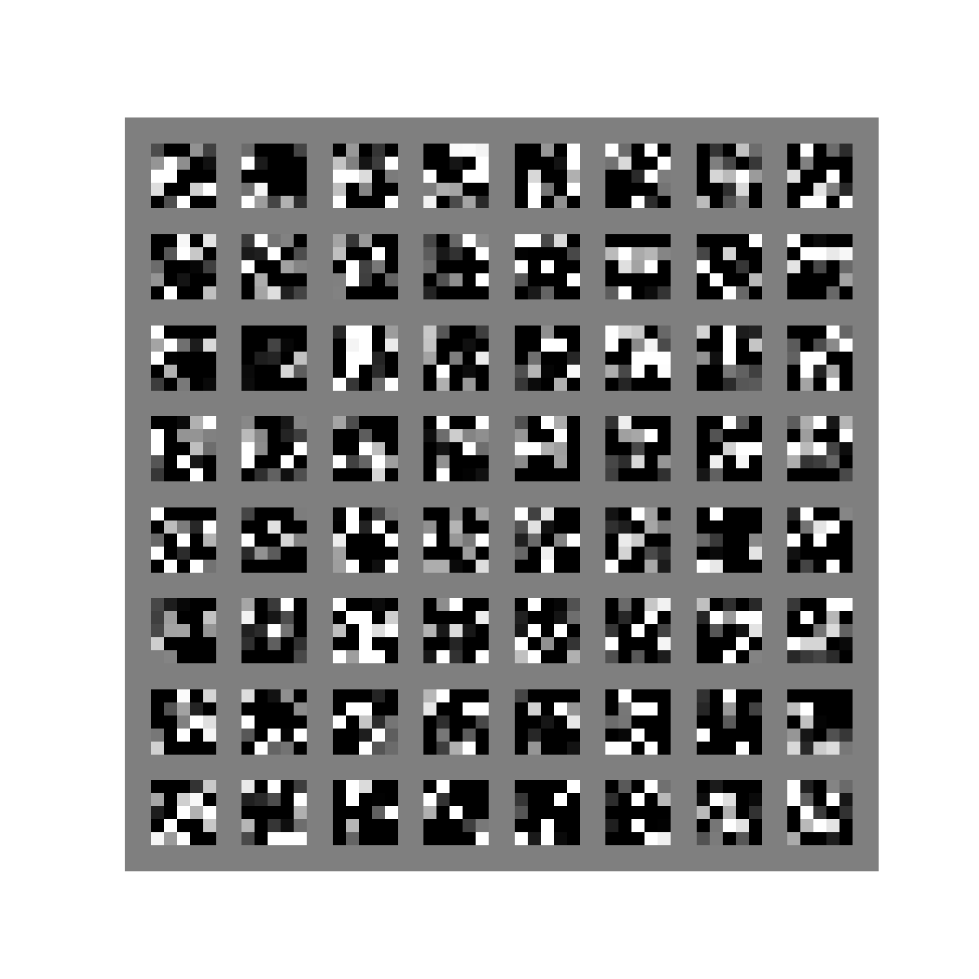
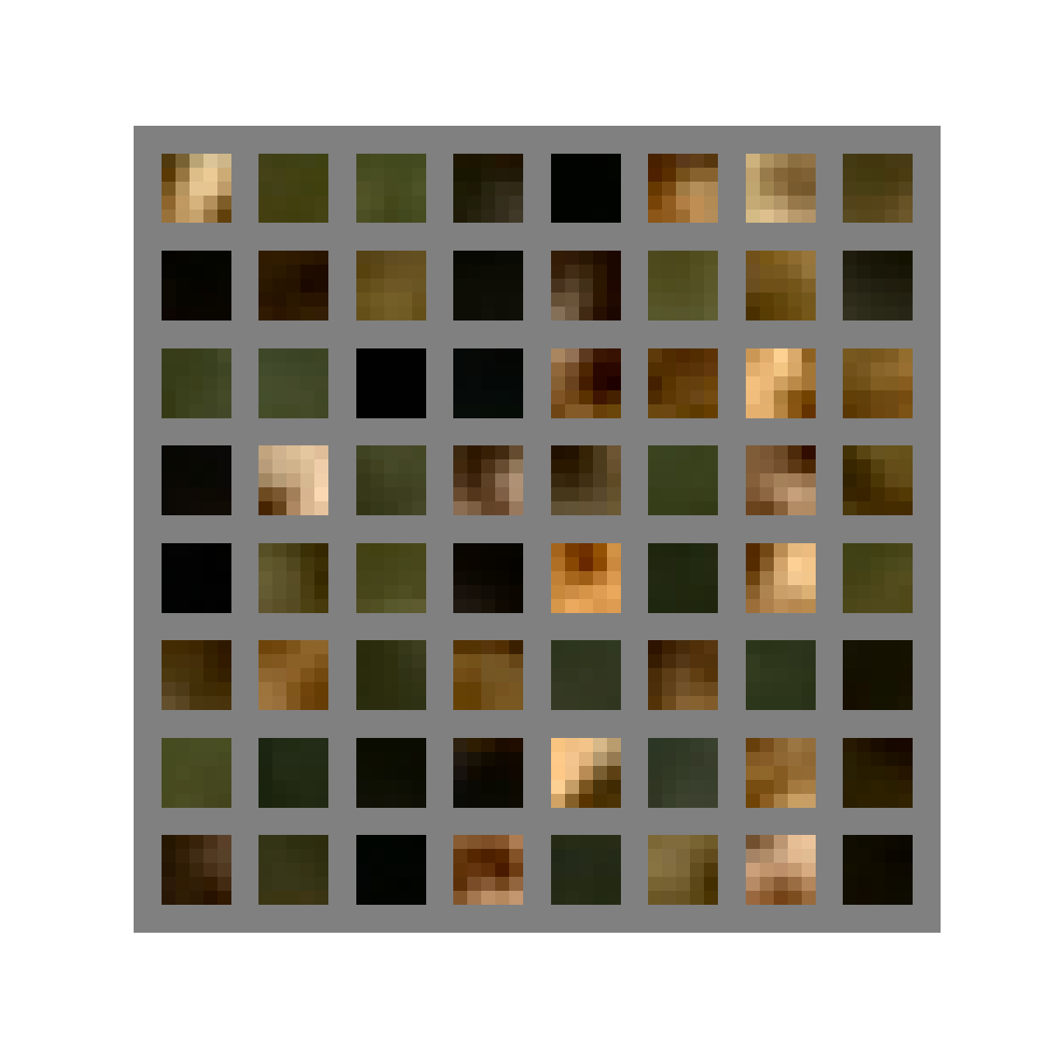
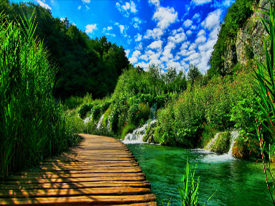
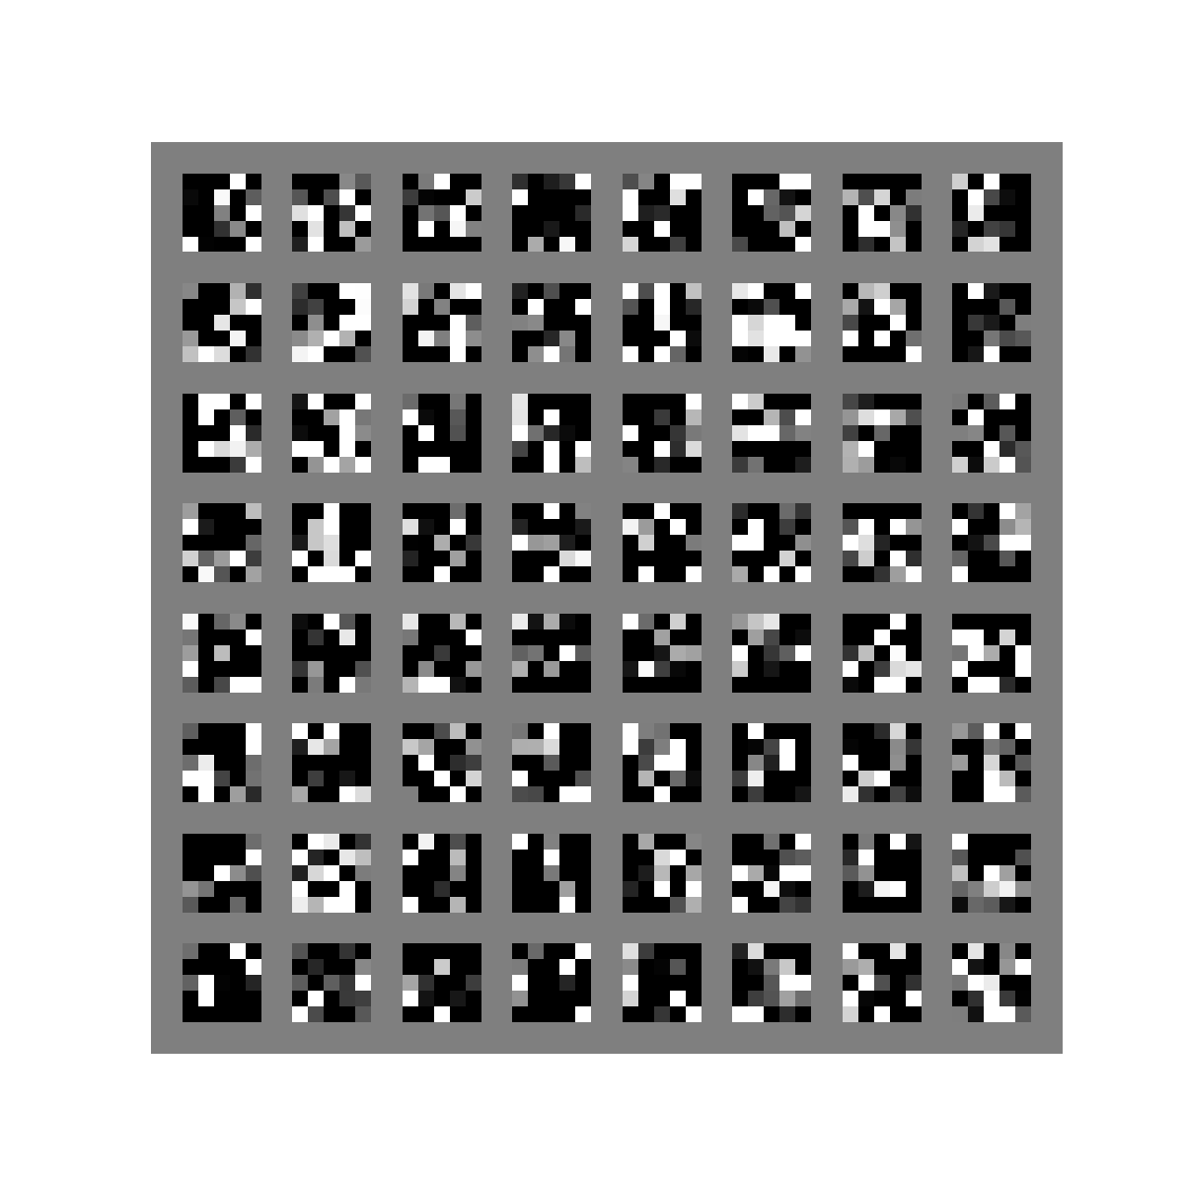
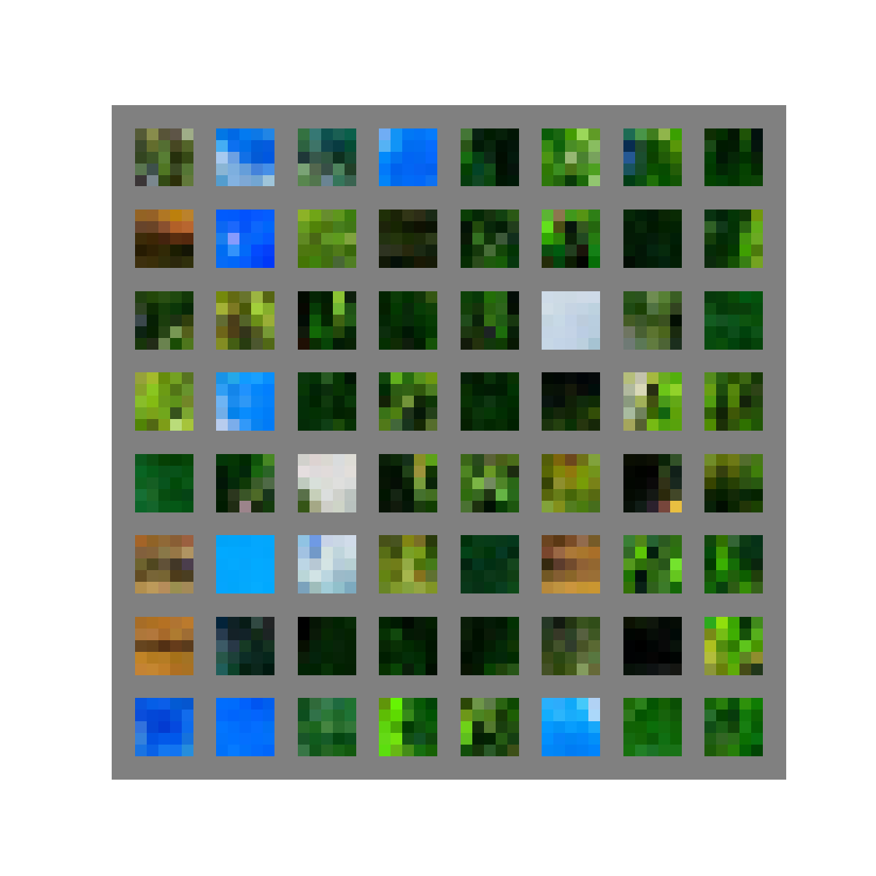
Experiments
CHEETAH Dataset Samples
NATURE Dataset Samples

Slide 11
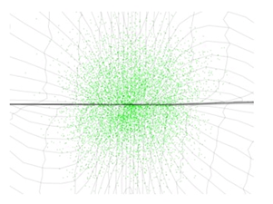
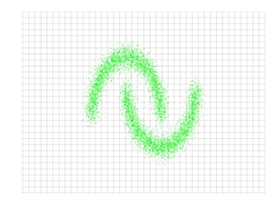
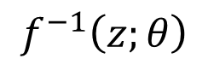
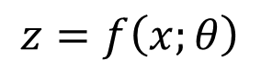
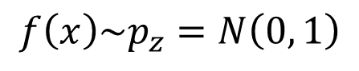
Enforcing Distribution
$$x\sim p_{x} \\ \left(images? patches?\right)$$
$$f\left(x\right)\sim p_{z}=N\left(0, 1\right)$$
$$z=f\left(x;θ\right)$$
$$f^{−1}\left(z;θ\right)$$
?

Slide 12
Distance From Gaussian

Slide 13
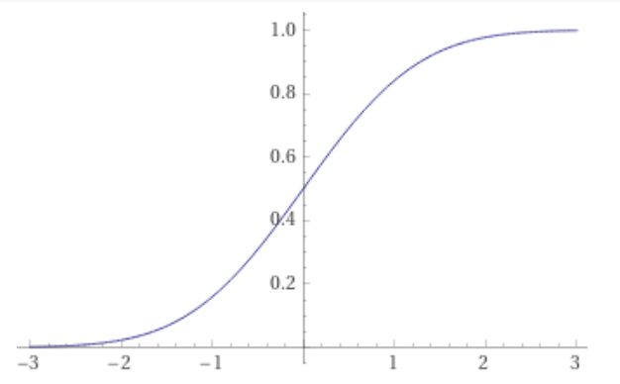
Distance From Gaussian – 1D KS Test

Slide 14
Distance From Gaussian – 1D KS Test
?
1. Gauss in each dim

Slide 15
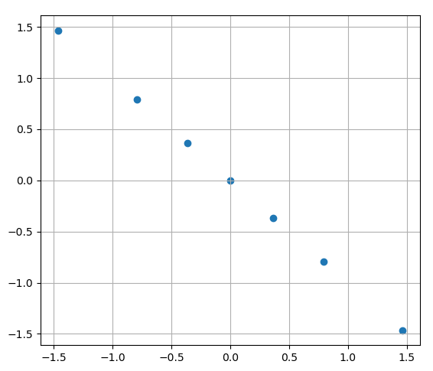
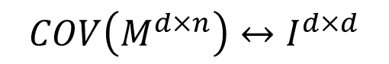
Distance From Gaussian – 2D?
$$COV\left(M^{d×n}\right)↔I^{d×d}$$
2. Dims are uncorrelated

Slide 16
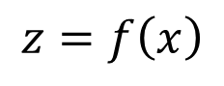
Enforcing Distribution
$$x\sim p_{x} \\ \left(images? patches?\right)$$
$$f\left(x\right)\sim p_{z}=N\left(0, 1\right)$$
1. Gauss in each dim 2. Dims are uncorrelated
?
$$z=f\left(x\right)$$

Slide 17
Sanity Check
Notes:
Cheetah, 10*10, vardeq

Slide 18

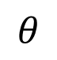
Enforcing Distribution
$$x\sim p_{x} \\ \left(images? patches?\right)$$
$$f\left(x\right)\sim p_{z}=N\left(0, 1\right)$$
1. Gauss in each dim 2. Dims are uncorrelated
?
$$z=f\left(x\right)$$
$$θ$$

Slide 19
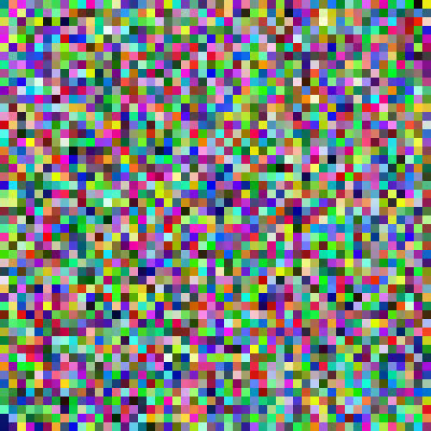

Image Space Search – Init Random
Gauss in each dim: 0.35 Dims are uncorrelated: 0.01 Not Yet Converged
Notes:
Init Random, 50*50
10k iters
2cws7qxi, wise-gorge 160
Init Random, 48*48
100k iters
3dolj8i2, honest-donkey-163

Slide 20

Enforcing Distribution
$$x\sim p_{x} \\ \left(images? patches?\right)$$
$$f\left(x\right)\sim p_{z}=N\left(0, 1\right)$$
1. Gauss in each dim 2. Dims are uncorrelated
?
$$z=f\left(x\right)$$
$$θ$$

Slide 21

Image Space Search – Init Cheetah Blur 11*11
Gauss in each dim: 0.003 Dims are uncorrelated: 0.0003
Not Yet Converged
Notes:
Init Cheetah Blur 11*11 2zmf3brs, vocal-microwave-161

Slide 22



Enforcing Distribution
$$x\sim p_{x} \\ \left(images? patches?\right)$$
$$f\left(x\right)\sim p_{z}=N\left(0, 1\right)$$
1. Gauss in each dim 2. Dims are uncorrelated
?
$$z=f\left(x\right)$$
$$z$$
$$θ$$

Slide 23

Image Space Search – Deep Image Prior
Gauss in each dim: 0.1 Dims are uncorrelated: 0.002 Pretty Converged
Notes:
Deep Image Prior Init Random, 48*48 3qo0526u, cosmic-frog-162

Slide 24

Image Space Search – SWD
Notes:
Init Random, 48*48
10k iters
1162qvr2, dashing-eon-164

Slide 25
Image Space Search – SWD
Notes:
Init Cheetah Blur 11*11 2l38tcr7, warm-sum-165

